Slide 1
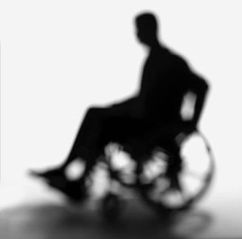
Virtual Reality and Associated Technologies in Disability Research and Intervention
P L Santos, M Maia, A Tavares, M Santos & M Sanches-Ferreira

Slide 2
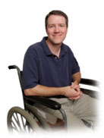
MEDICAL
A problem located in the person
that has to be fixed, remediated or compensated
within a medical context
independently of the people’s environment.
Disability is ...

Slide 3
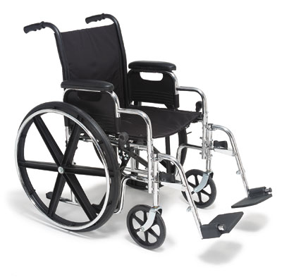
Can’t use hands
Needs a doctor
Needs
Institutional
care
Can not walk
Can not talk
Needs help
Can not see or hear
Needs a cure

Slide 4
A problem in the environment
that has to be changed with social/political measures
independent of the functioning of the person
Disability is…
SOCIAL

Slide 5
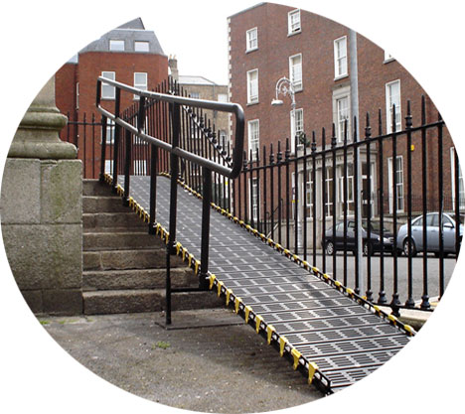
Badly designed buildings
Inaccessible transport
Hypocrisy
Prejudiced attitudes
Poor job
prospects
No parking
spaces
Segregated education
Isolated families

Slide 6
MEDICAL
BIOPSYCHOSOCIAL MODEL
A problem located in the person
that has to be corrected, remediated or compensated
within a medical context
independently of the environment of that person.
Tries to bridge the gap between this two models:
Disability is
Social
A problem in the environment
that has to be changed with social/political measures
independent of the functioning of the person
Environmental
Personal
Disability is…
SOCIAL
SOCIAL

Slide 7
Goals of the study
Identification of the conceptual frameworks of disability
Key components of functioning and disability (e. g. body functions and structures, activities, and participation) adressed
Inclusion of contextual factors focused on promoting participation
Evaluation of effects of VRAT applications through performance assessments in the real world.

Slide 8
Method
Sample
144 papers that explicitly documented the use or potential use of the VRAT system in the assessment or the rehabilitation of persons with disabilities.
Procedure
Contents were analyzed through a coding scheme.
Each paper was independently coded by three of the authors.
Codes were compared and agreements were generally above the 90% level in each coding category.
Disagreements were discussed until divergences ceased.

Slide 9
Coding Scheme
General Classification | Identifier | Components of human functioning | Contextual Factors | Performance assessment in the real world
Medical | Pathology | Body Functions and structures | Settings similar to everyone | Yes
 | Impairment
Social |  | Activity (acts and tasks)
 | Activity Limitation |  | Individualized contexts | No
Biopsychosocial | Participation Restrictions | Participation (societal involvement)

Slide 10
Percentages of sampled documents in each of the examined years
 | TOTAL NUMBER | SAMPLED NUMBER | PERCENTAGE
1996 | 30 | 16 | 53.33 %
1998 | 31 | 16 | 51.61 %
2000 | 42 | 31 | 73.81 %
2002 | 34 | 24 | 70.59 %
2004 | 43 | 27 | 62.79 %
2006 | 40 | 30 | 75.00%
TOTAL | 220 | 144 | 65.54 %

Slide 11
Proportion of studies representing the medical or the biopsychosocial view

Slide 12
Number of studies addressing Activity, Body Functions, and Participation

Slide 13
Number of studies including contextual factors

Slide 14
Relevant Aspects
1 Different perspectives seem to exist in the examined papers.
2 Most of the studies reviewed adressed activity limitations and only a few with participation issues.
3 Interventions focused on participation require the use of strategies to habilitate environments: this habilitation should bring benefits for everyone, not just for those to whom the intervention is intended.
4 To overcome the problems of innovation, availability, quality and cost, the design of assistive-type technologies should seek universal design. This issue has not been systematically adressed in the sampled studies.
5 Using VE in disability research and practice makes more sense when interactions between physical factors and personal variables are considered. Thus, one of the challenges of designing VE scenarios is to use parameters adjustable to each user.
6 A very small number of studies have evaluated effects of VRAT applications through performance assessments in the real world. Two possible reasons: (1) research has not reached the stage that allows that assessment; (2) the principle that treatments should maximize functioning and independet living in the real world is yet to be incorporated.

Slide 15
Thank you for your attention

